Slide 1
Asurion Mobile Applications Project Genesis – Platform Optimization
April 2014

Slide 2
Jim Talbot to share project plan and deliverables from next meeting
Cloud versus on-premise – Jingming to schedule separate discussion to close on this
Cloud security model so we can host PII data in cloud – Mark C to drive this, it is a long-term initiative will not impact platform optimization
Project teams – use journey team model
Azure common stack – Arun to setup meeting with Sri, Omri, Mark, Vamshi, Jingming so that we have a common azure stack as much as possible

Slide 3
Goals – Platform Optimization (Jingming to update slide)
Deliver a new platform designed around fine grained services
Reduce investment in current platform with minimal impact to current commitments
Work towards the following goals architecturally (KPI/goals assume appropriate hardware capacity to meet goals)
Themes | KPI
Scalability | Unlimited
Availability | 99.99+%
Performance | < 4 sec end-to-end service responsiveness
New carrier deployment | < 1 month for standing up a new carrier
 | End to end multi-tenancy
Technology independence | Agnostic – no affinity to specific underlying technology
Fast prod deployment | < 30 minutes prod deployment per app server
Dynamic production configuration | Supported without restarts
Distributed load | Real time performance based load balancing
Operational Insights | Real-time single point monitoring
System robustness
Time to market
Operational efficiency

Slide 4
Project GENESIS – Platform Optimization
Goal: Build new and existing business capabilities (1) fast (2) with very high scalability & availability (3) utilizing cloud PAAS as much as possible
Approach: Build independent services on Azure cloud first. Migrate – if needed – any services that need to be on premise due to PII restrictions.
Impact to existing commitments: Mitigate by executing existing commitments under the greenfield approach where ever possible. Aggressively onboard resources as they become available.
Project start date: June 2014 (waiting on approval)

Slide 5
Impact to current platform commitments
Commitment | Target | Plan | Resources -> Genesis
SG 3.0 REST, Labs 8.0 | 6/30 | Complete as planned
Data Model Optimization | 8/30 | Complete as planned | 2 resources to genesis (Sep)
Oracle Migration | 12/31 | Complete as planned with 1 DBA, 1 Dev resource
Verizon App Resiliency Ph II | 9/30 | Complete as planned | 1 resource to genesis (July) 1 resource to genesis (Aug)
Platform Scalability & Capacity Improvements | 7/31 12/31 | Complete to 2500-3000 TPS by 6/30 Continue with caching to 4000 TPS | 2 resources to genesis (July) 1DBA, 1 Dev continue on caching
Jabber Deprecation | N/A | Replace by genesis

Slide 6
PA Platform – Scalability Roadmap
 | TPS | Estimated TPS
SG 1.0 | 200 TPS
Glory (core-carrier integration) | 700 TPS
Tuning and optimizations | 1000 TPS
Hazelcast eviction improvements | 1300 TPS
Database separation | 1700 TPS
Location servlet | 2100 TPS
Jabber optimization, PAQ servlet |  | 2500-3000 TPS (mid-June)
Caching |  | 3500-4000 TPS (Dec)
Sharding |  | Beyond 5000 TPS

Slide 7
PA - Business Capabilities (Aaron/Jingming to provide updated deck)
Device Registration
Device Setup
Account Verification
Device Data Protection
Contact Backup/Restore/Sync
File Backup/Restore/Sync
Eligibility Notification
Web Personal Content Management
Device Recovery
Lock
Locate
Wipe
Alarm
Device Premier Support
Remote control
Agent device management
Pro-active support notifications
Device Security
Threat Scan
Safe browsing
Upgrade & downgrade
Trial
Carrier Login Integration
Factory Reset
Play Integration
Acceptance of agreements
Integration Services
Device Settings Management
Click-to-call
Click-to-chat
Healthscan
Anti-virus
Supporting Services
Device Profiling
Device Notification
Text Messaging
Native Push Messaging
Email
Device Telemetry
App usage
Battery usage
Device settings
Agent management
Application scrapers
Battery analysis
Application privacy assessment

Slide 8
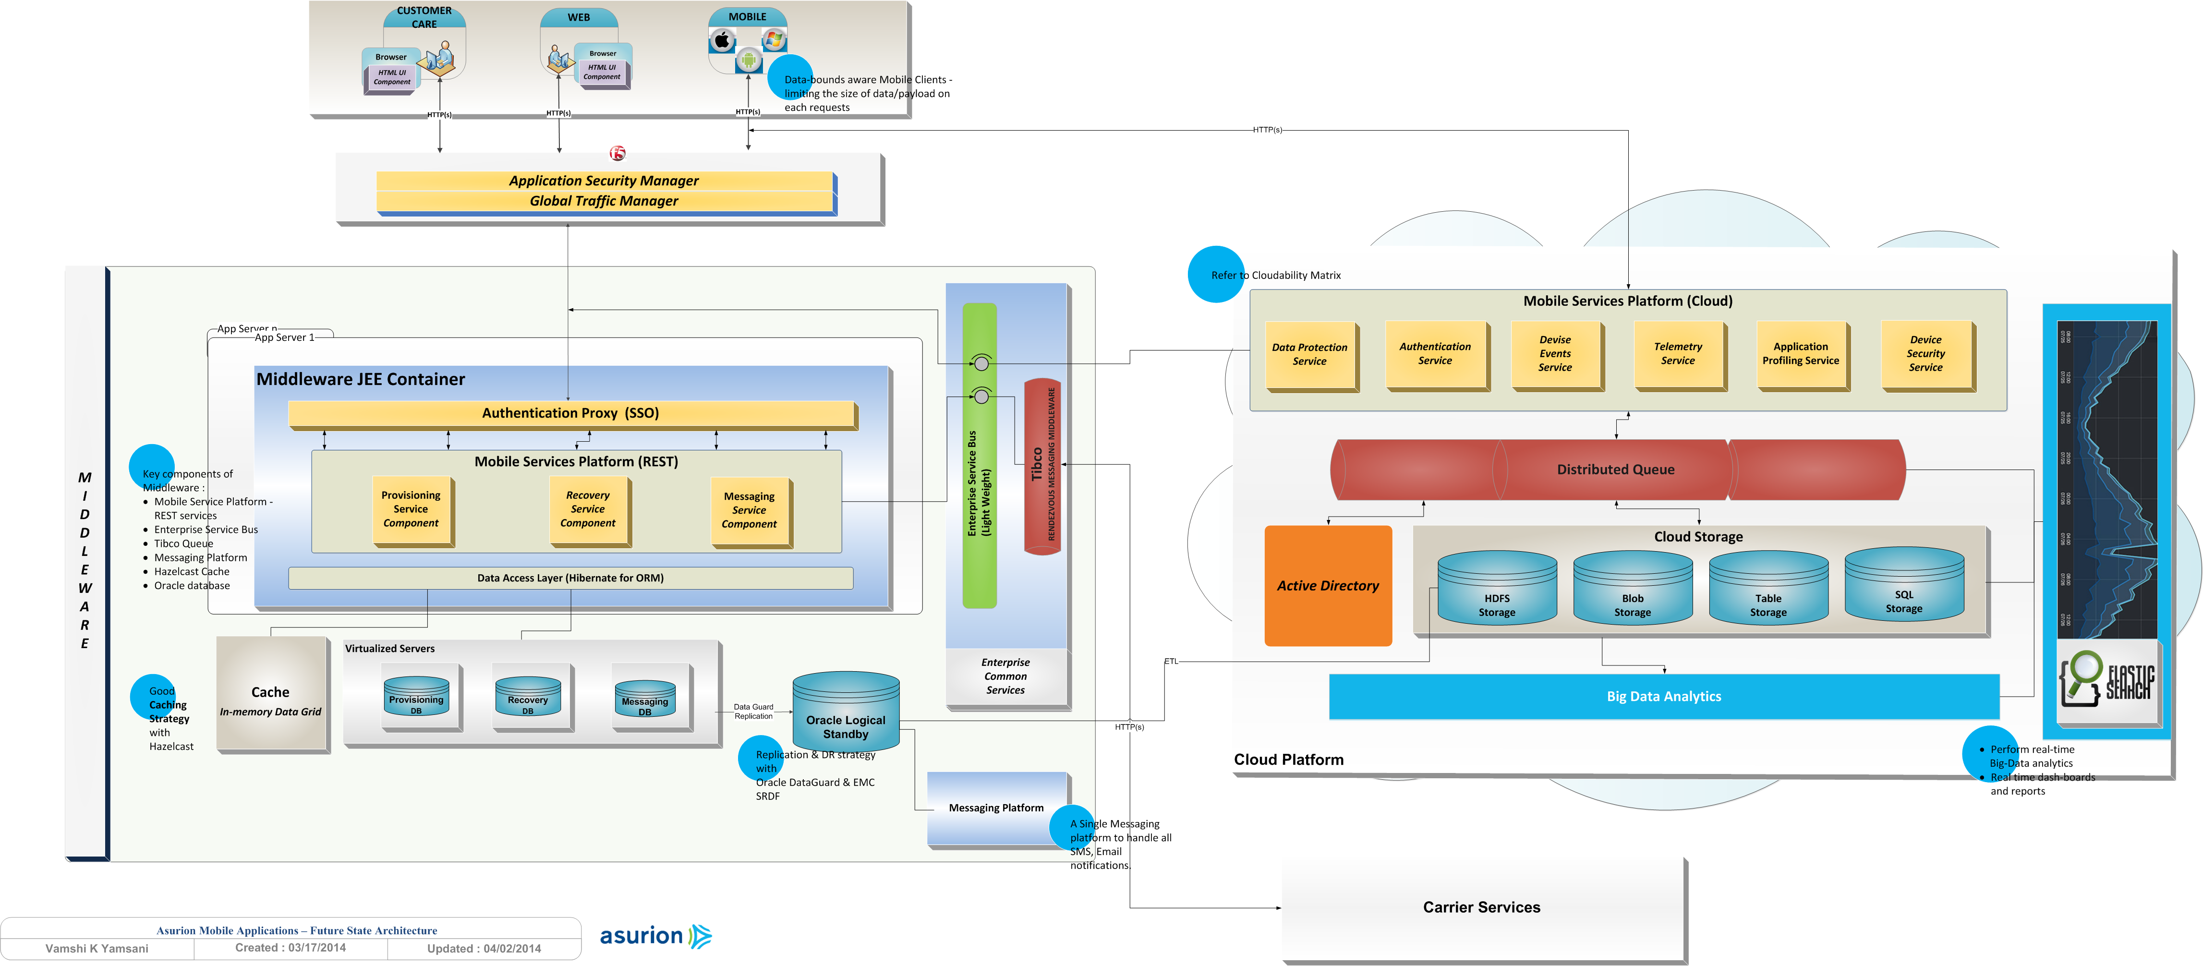
PA Transformation - Proposed Architecture

Slide 9
Journey Team Process – Idea to Production Lifecycle
Dashboard & Numbers
AB testing
Learn User Experience
Create new user stories
User Story
Analysis
Development
Quality
Demo
Production
Learn
MVP
Spec
High level Design
KPIs
Releasing the feature
Feature flags
Break into tasks Design
UX
Implementation & TDD
Product, UX and Developers
experience as users
Acceptance tests

Slide 10
Roles & Responsibilities
Level 0 definition – Roles, Architect, etc.
Level 1 definition – Dev Structures, SDLC
Activities – follow under structure

Slide 11
Genesis Phases
Phase | Goals | Timeframe Estimate
Planning phase | Align on approach, architecture, environment setup, resources, training | June
Phase I – POC Cloud implementation of Business Services | Implement business capabilities in the cloud - “POC” quality – feature and function but not productized | July – Dec
Phase II – Productization | Migrate PII services to on-premise, cover edge cases, load testing, business requirements, migration strategy
Phase III – Carrier Deployment | Carrier integration, data migration tool,

Slide 12
Next Steps
Task | Owner | Duration | Target | Status
Planning Phase
Azure Cloud infrastructure – dev & qa environments | Mark | 1 week | Early June | Requested
Cloud Architecture | Vamshi | 2 weeks | Mid-June | Working
Basic “Hello World” service on Azure | Arun | 1 week | Early June | Done
Pipeline for Synechron Contractors | Arun & Vamshi |  | Ongoing | In Progress
Azure Training Material (from Microsoft)? | Vamshi | 2 weeks | Mid-June | Working
Sandbox scribbles service POC | Arun | 2 weeks | End-June | Planned
Phase I – POC Cloud Implementation of Business Capabilities
Authentication, MS, MR, Notification | Team | 3 months | Mid-Sep | Planning
Provisioning, DP, others | Team | 3 months

Slide 13
Genesis Services
Service | Business Capability | Existing Commitment | Implementation | Duration | Target
Scheduler Service – POC | (supporting) | Platform Scalability | Replace Scribbles/Quartz/Externals – scalability bottleneck | 2 weeks | End Jun
Device Security | Device Security | Platform Scalability | Security services – virus scan, health scan, threat scan | 6 weeks | Aug – Sep
Device Recovery | Device Recovery | Application Resiliency | Lock, locate, alarm, wipe, factory reset | 6 weeks | Sep – Oct
Device Notification | Device Notification | Application Resiliency | SMS, GCM, APNS, Email | 4 weeks | Oct
Authentication Service | (supporting) | Application Resiliency | Authentication and validation of handset & web | 4 weeks
Device Data Protection | Device Data Protection |  | File & Contact backup, restore, sync, management | 12 weeks
Device Registration | Device Registration |  | Provisioning – auto and manual | 8 weeks
Device Profiling | Device Profiling |  | Application analysis, battery analysis
Device Telemetry | Device Telemetry |  | App usage, battery usage, device settings, agent management

Slide 14
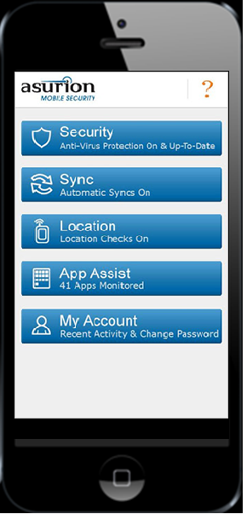
Genesis App
Cloud Services
Genesis App
Device Registration
Registration Service Implementation
Blob Storage
Provisioning
Distributed Queue
File Sync
Device Data Protection
Data Protection Service Implementation
Contact Sync
Table Storage
Device Recovery
Recovery Service Implementation
Locate
Virus Scan
Device Security
HDFS
Security Service Implementation

Slide 15
Handset & Web Integration
Genesis App
Provisioning
File Sync
Contact Sync
Locate
Virus Scan

Slide 16
Reference Slides

Slide 17
PA Transformation - Proposed Architecture

Slide 18
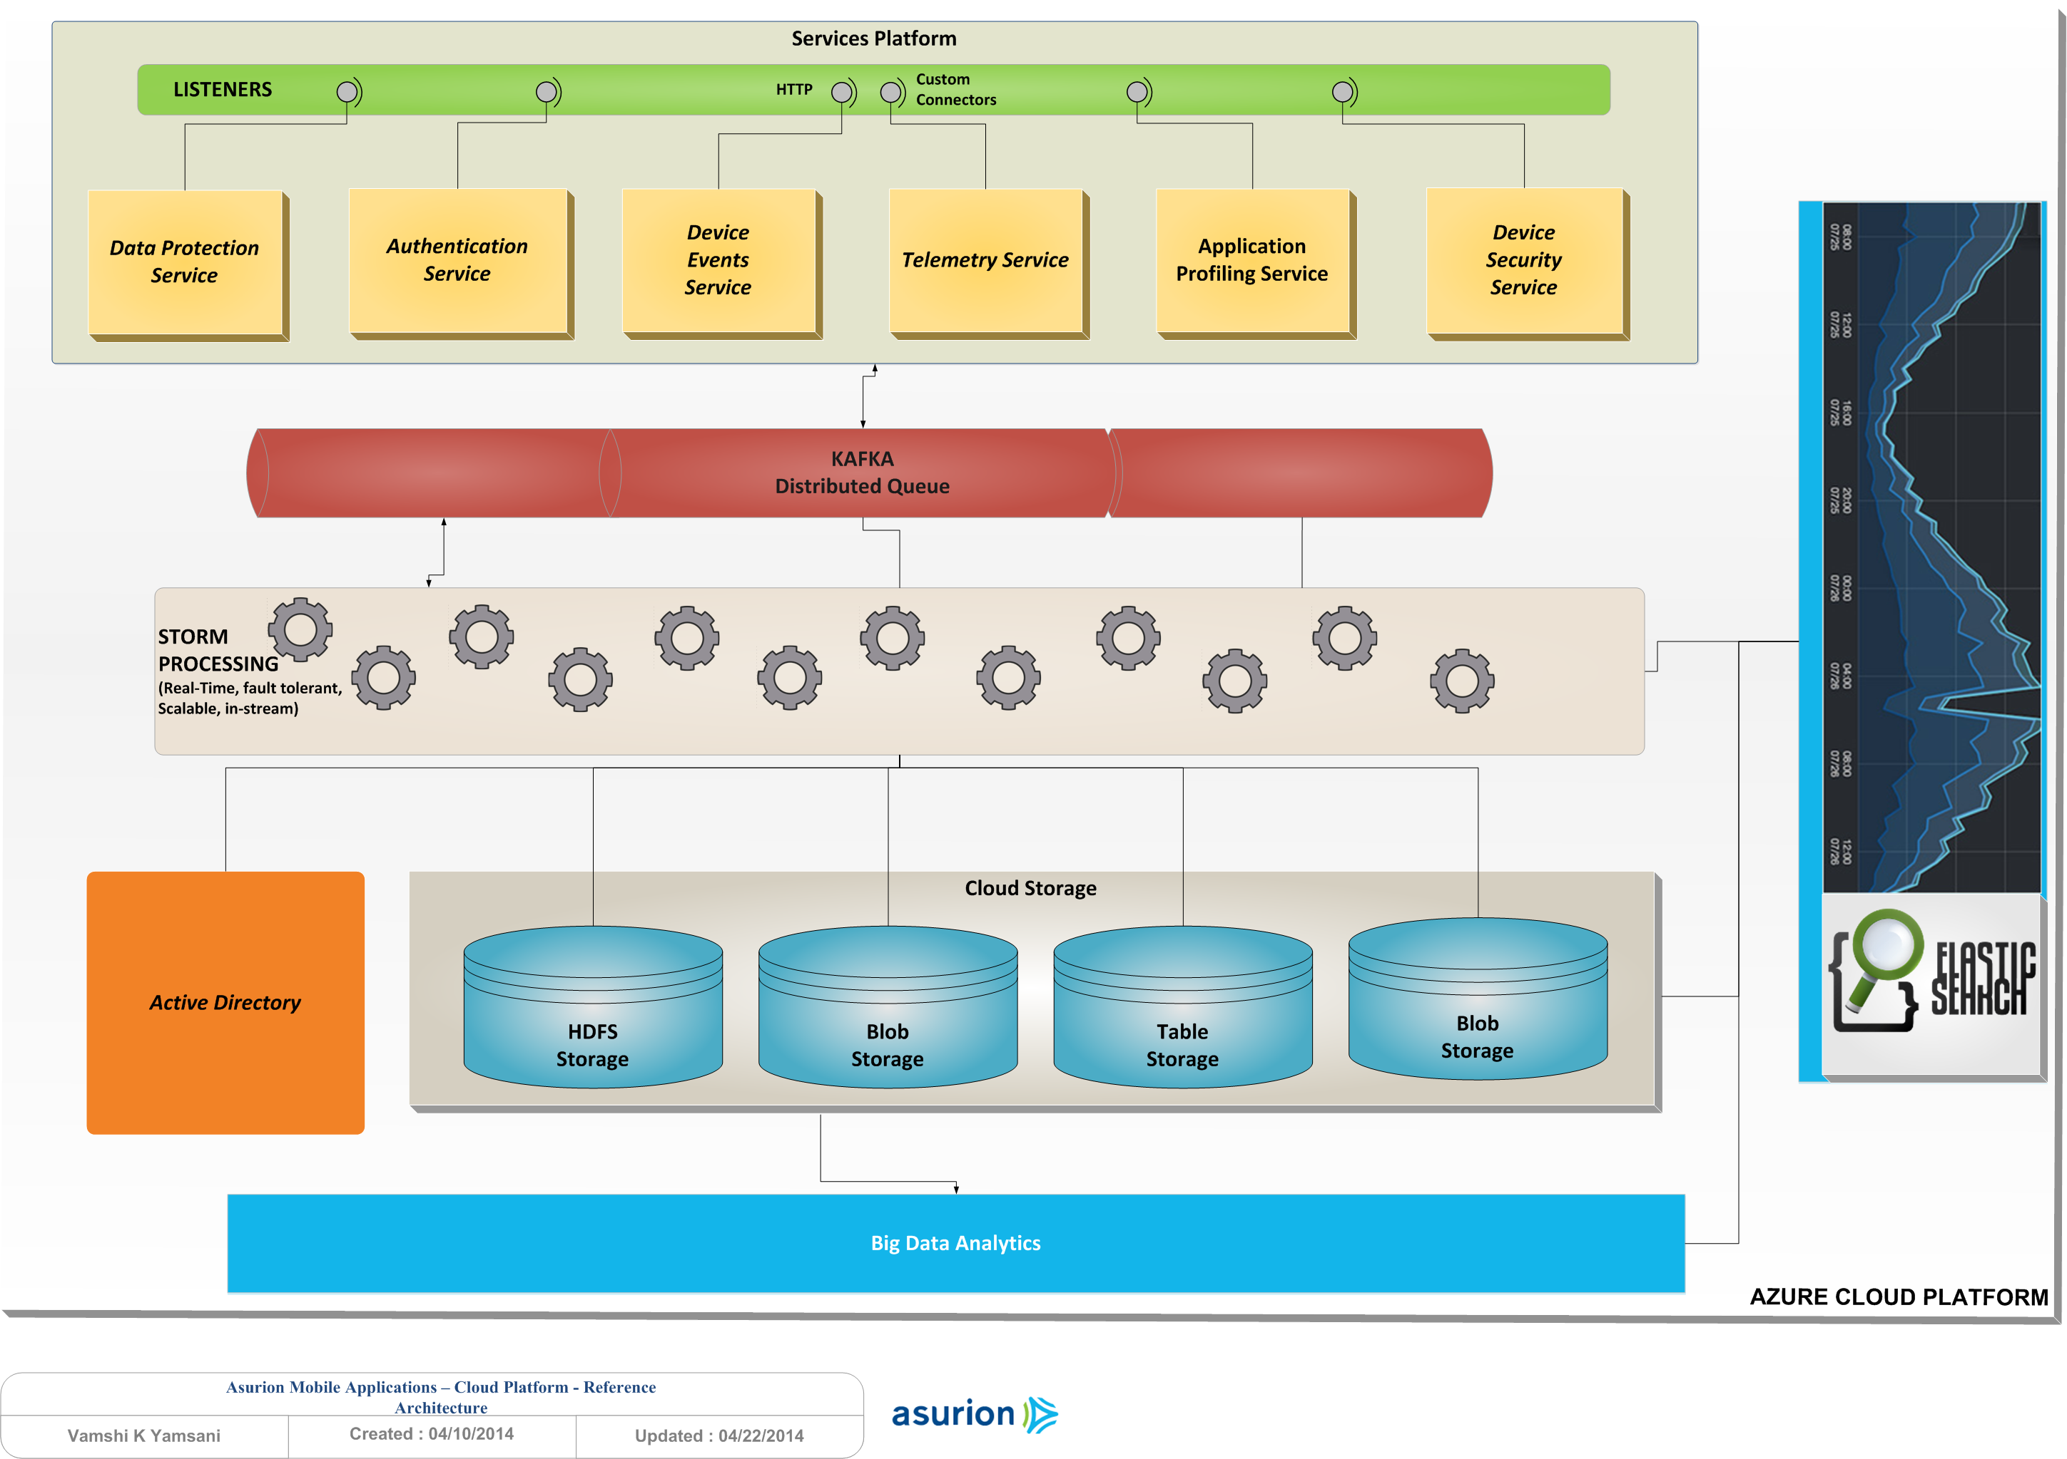
PA Transformation - Cloud Reference Architecture

Slide 19
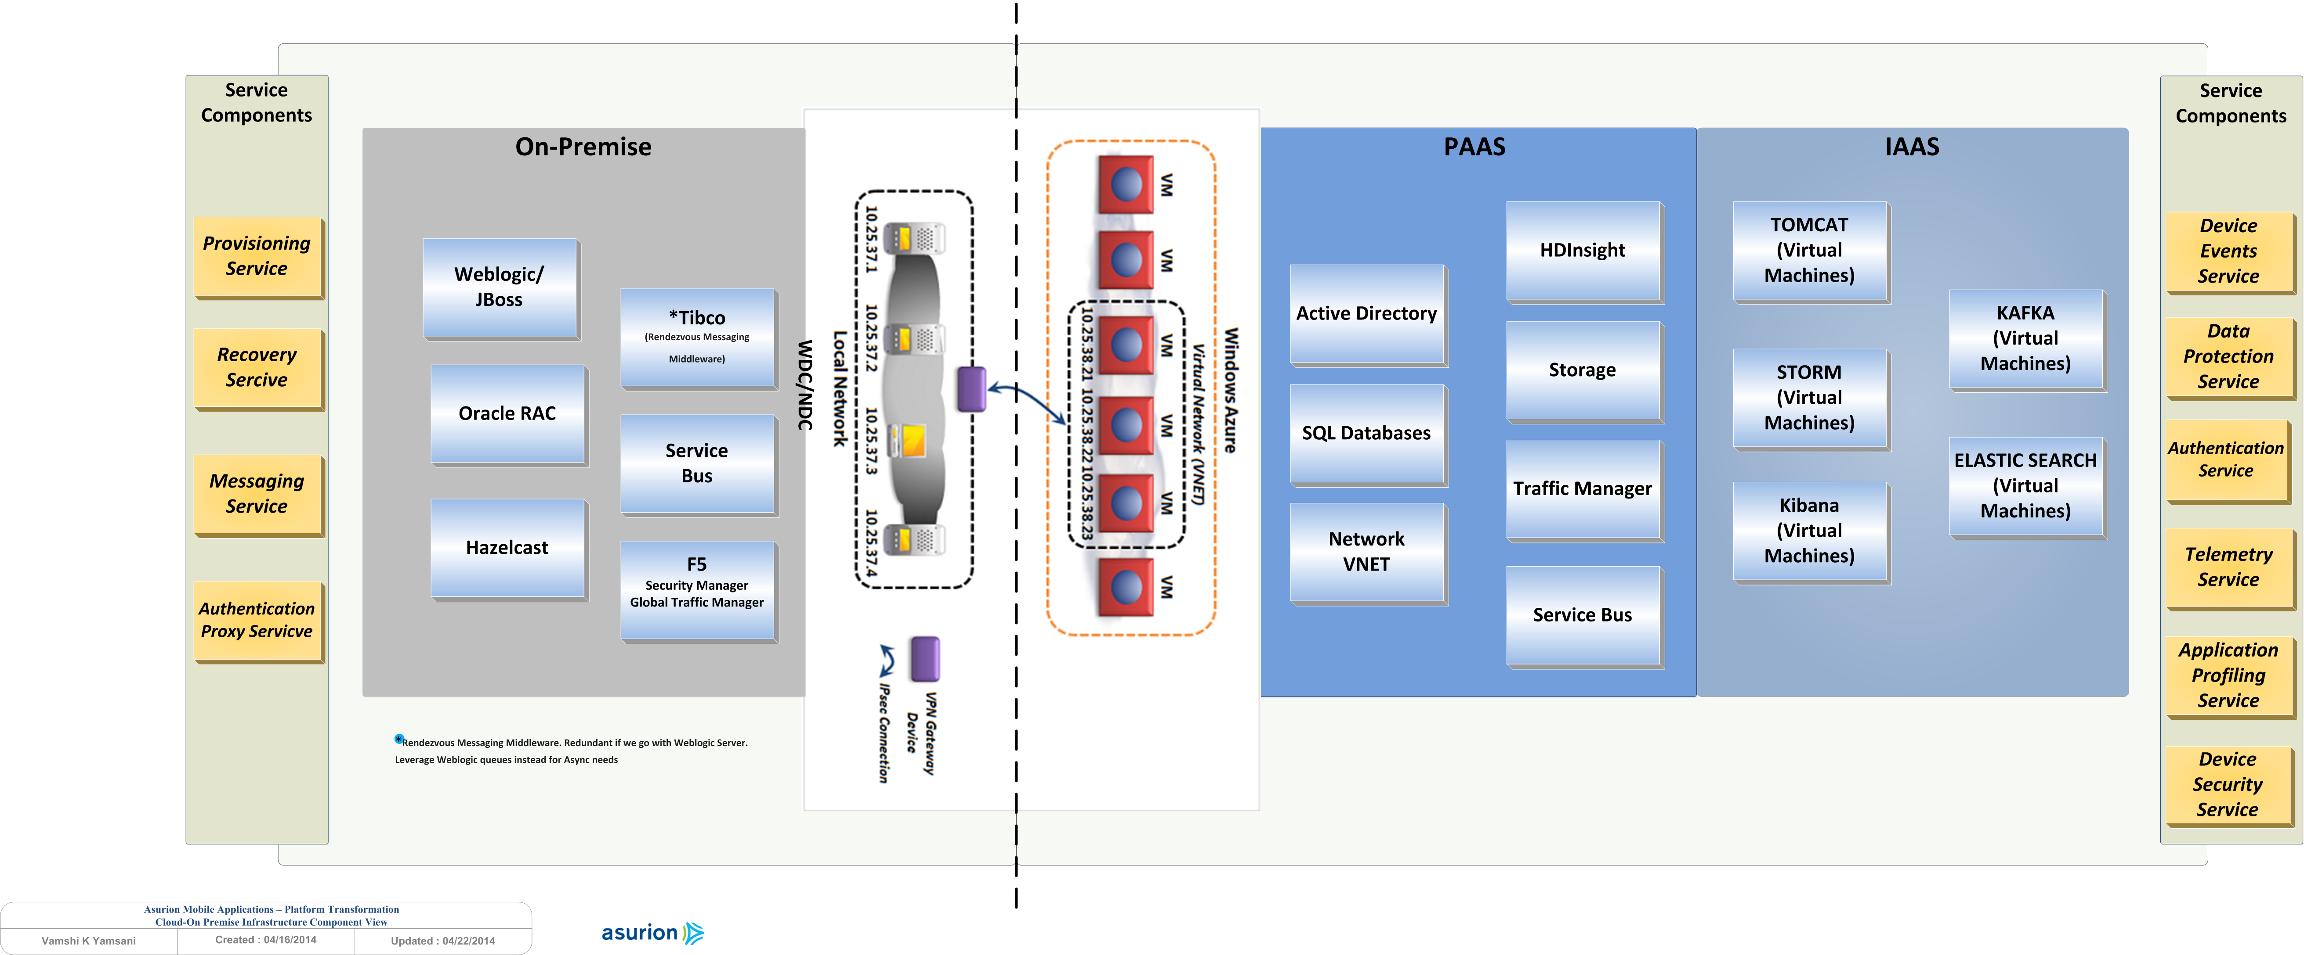
PA Transformation – Infrastructure Component View

Slide 20
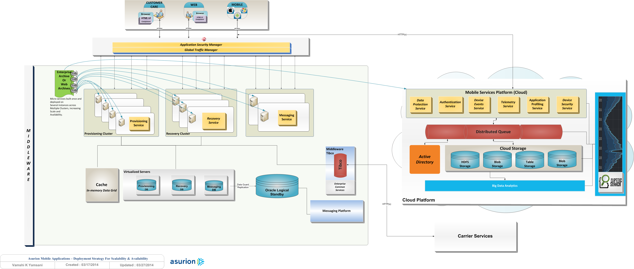
Deployment View

Slide 21
Journey Team Structure
Each team responsible for their own backlog and KPIs
Co-location is ideal and we will strive for this where possible
Clarity around KPIs and responsibilities
Syncing between teams, sharing ideas and staying in alignment architecturally is imperative
Team capabilities to drive a task end-to-end is ideal, there will be instances where teams will leverage other areas that have domain expertise
Examine and change if needed as necessary

Slide 22
Journey Team - Best Practices
Build MVP to gather quick feedback (lean) / align expectations (strategic) – learn!
Eliminate waste – automate repetitive steps, nightly regression, single trunk development, reuse features/functionality across implementations and solutions to reduce time-to-market
Continuously deliver to burn down the backlog, deploy, learn and measure to meaningfully impact the KPIs
Architect to fail-open and design to be hardware/network failure resilient
Develop with feature-flag configurations to allow A/B testing and controlled, risk-mitigated releases
Have persistent, co-located, small, high output quality teams

Slide 23
Journey Team Process – Idea to Production Lifecycle
Dashboard & Numbers
AB testing
Learn User Experience
Create new user stories
User Story
Analysis
Development
Quality
Demo
Production
Learn
MVP
Spec
High level Design
KPIs
Releasing the feature
Feature flags
Break into tasks Design
UX
Implementation & TDD
Product, UX and Developers
experience as users
Acceptance tests

Slide 24
Team Structure - example
 | Team/ Parameter | More Utilization (TLV) | Improve Resolution (TLV) | Improve Resolution (Nashville)
Capabilities | Relationship with Technicians | V | V | V
 | Integration with KANA | V | V | V
 | App dev. | V | V | V
 | Web dev. | V | V | V
 | IVR dev. |  |  | V
 | Back End dev. | V | V | V
 | Comm. tools | V | V | V
Members | Tech Lead | Omer Baki | Asaf Kotzer | Greg Newton
 | Product | New PM (Merav) | Ofer Padan | Simon Harper
 | UX | Amitay Lev | Rotem Lanir | ??
 | Developers | Elad, Omri, Rotem, (QA) | Amir, Or, Yshay, Zahi, Maria | Guru, Michael, Jagan, Satish

